Slide 1
CUSTOMER SEGMENTATION
Notes:
© Copyright PresentationGO.com – The free PowerPoint and Google Slides template library

Slide 2
TABLE OF CONTENTS
Problem statement
Introduction
RFM Analysis
Data Preprocessing
Ml Algorithm used
Applications of the model
Buisness value proportion
Conclusion

Slide 3
Problem statement
Our retail company aims to enhance its marketing strategies and improve customer satisfaction by implementing a customer segmentation strategy. The objective is to divide our customer base into distinct groups based on their shared characteristics, preferences, and behaviors. By identifying these segments, we can tailor our marketing efforts, product offerings, and customer experiences to better meet the unique needs of each group, ultimately leading to increased customer loyalty, higher conversion rates, and improved revenue.

Slide 4
Introduction
The goal of this project is to segment customers based on their transaction behavior using RFM (Recency, Frequency, Monetary) analysis and KMeans clustering.
We will be using an E-Commerce dataset to perform the analysis and identify different customer segments.
Notes:
© Copyright PresentationGO.com – The free PowerPoint and Google Slides template library

Slide 5
RFM Analysis
RFM analysis is a powerful customer segmentation technique used in marketing and analytics.
Recency: How recently a customer made a purchase. A higher recency value indicates a more recent purchase.
Frequency: How often a customer makes a purchase. A higher frequency value indicates frequent purchases.
Monetary: The total monetary value of a customer's purchases. A higher monetary value indicates higher spending.
Notes:
© Copyright PresentationGO.com – The free PowerPoint and Google Slides template library

Slide 6
Data Preprocessing
We started by loading the dataset and performing data wrangling to handle missing values and negative quantities/prices
.The dataset was filtered to include only valid transactions with positive quantities and prices.
We calculated the revenue by multiplying Quantity and UnitPrice and converted the InvoiceDate to a datetime format.
Finally, we applied log transformation and normalization for clustering.
Notes:
© Copyright PresentationGO.com – The free PowerPoint and Google Slides template library

Slide 7
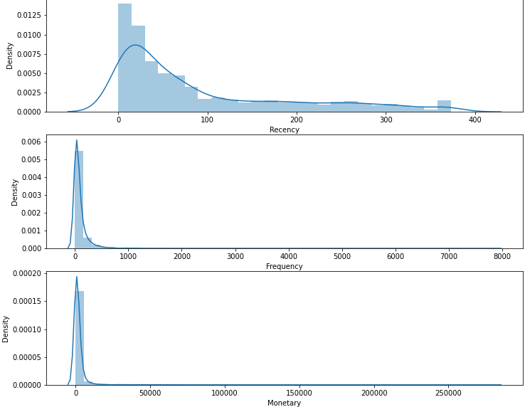
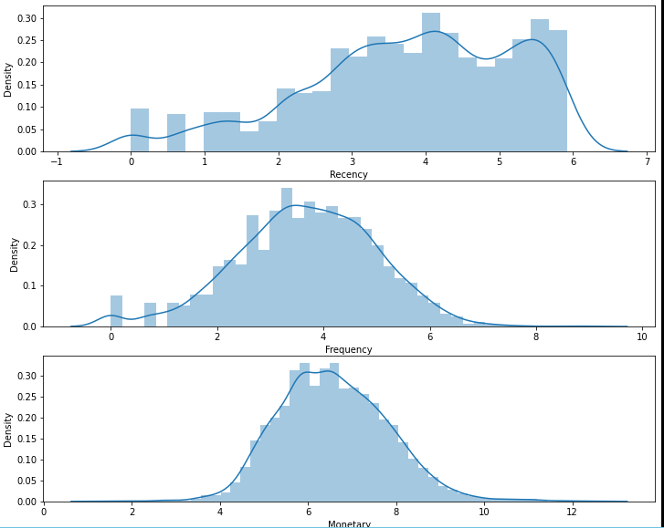
distribution of Recency, Frequency and MonetaryValue

Slide 8
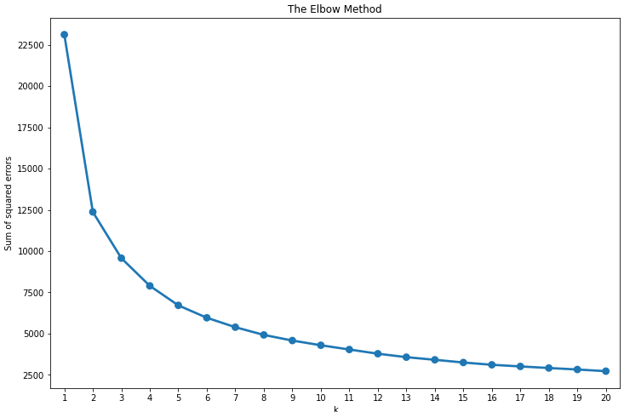
The Elbow Method

Slide 9
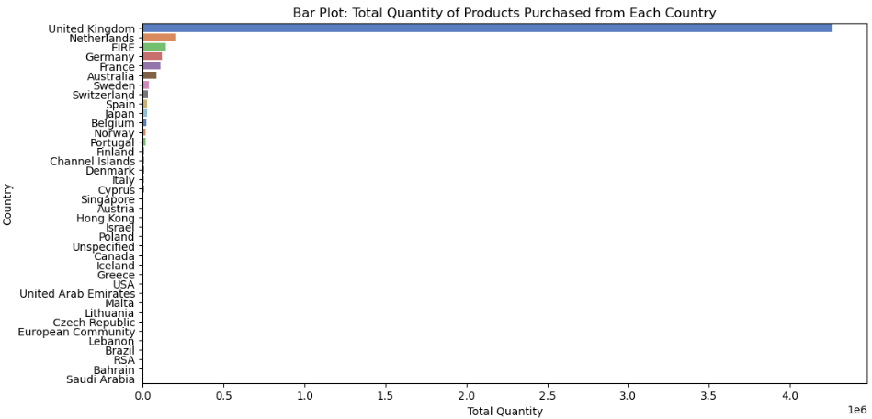
Total Quantity of Products Purchased from Each Country

Slide 10
K-Means Clustering
K-Means clustering is an unsupervised machine learning technique used for clustering data into groups.
We used the elbow method to determine the optimal number of clusters (K) for segmentation.
The clustering algorithm assigns each customer to one of the identified segments based on RFM scores.
Notes:
© Copyright PresentationGO.com – The free PowerPoint and Google Slides template library

Slide 11
CUSTOMER SEGMENTS
We identified four customer segments based on the KMeans clustering results.
Best Customers: High recency, frequency, and monetary value. These are our most valuable customers.
Loyal Customers: High frequency and monetary value but lower recency.
Potential Loyalists: High recency and frequency, but lower monetary value.
Needs Attention: Low recency, frequency, and monetary value. These customers may require targeted marketing efforts.
Notes:
© Copyright PresentationGO.com – The free PowerPoint and Google Slides template library

Slide 12
Buisness value proportion
Customer segmentation is a crucial strategy used by businesses to divide their customer base into distinct groups based on characteristics, behaviors, and preferences. This technique enables personalized marketing, product development, and pricing strategies. By understanding customer needs, businesses can improve customer experience, increase loyalty, and drive growth. Continuous monitoring and refinement of segmentation models ensure effective implementation.

Slide 13
Conclusion
Customer segmentation is a valuable technique to understand and target different customer groups.
The RFM analysis and KMeans clustering allowed us to identify distinct customer segments.
This information can be used for personalized marketing, customer retention, and business strategy.
Notes:
© Copyright PresentationGO.com – The free PowerPoint and Google Slides template library

Slide 14
User Input and Output
We developed a user-friendly web application to allow users to input transaction details.
Users can enter InvoiceNo, StockCode, Description, Quantity, InvoiceDate, UnitPrice, CustomerID, and Country.
After submission, the application calculates the customer segment for the provided data and displays it on the result page.
Notes:
© Copyright PresentationGO.com – The free PowerPoint and Google Slides template library

Slide 15
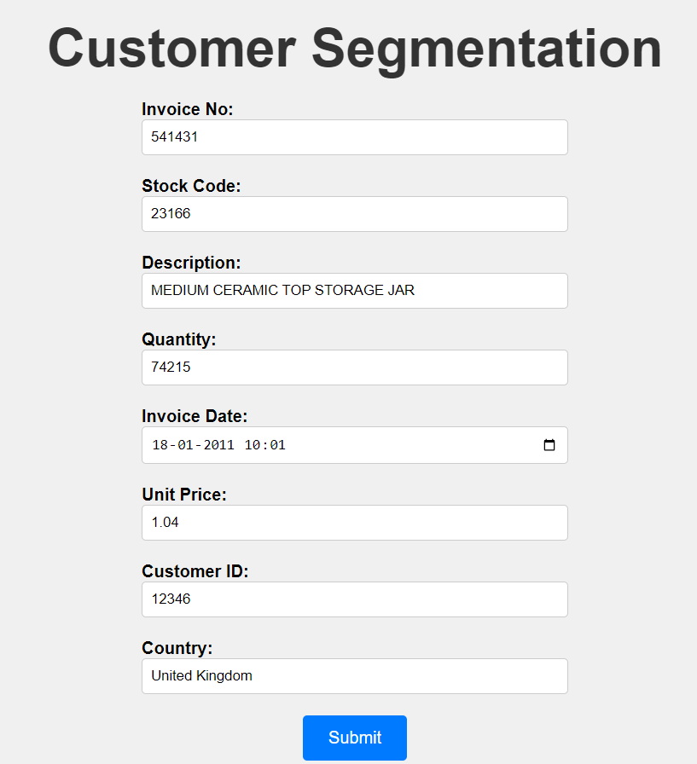
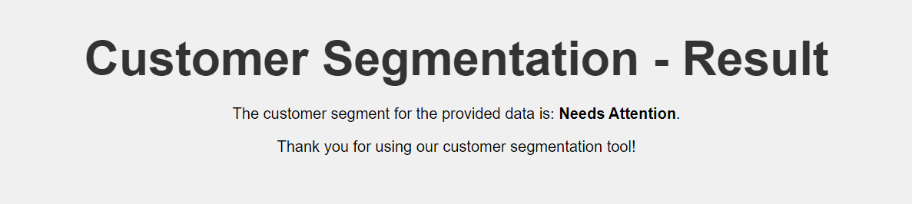
Input Field: Output Field:
Notes:
© Copyright PresentationGO.com – The free PowerPoint and Google Slides template library

Slide 16
Thank You!
Notes:
© Copyright PresentationGO.com – The free PowerPoint and Google Slides template library

